Slide 1
Obtaining High-quality Panorama from Videos
Motivation: The technology of stitching a set of images is widely used today. Sometimes we want to obtain a panorama from a video that is captured from a stationary point by rotating the camera. However, the video may suffer from motion blur, which is not wanted when we try to construct a panorama from it. In our project, we try to construct a panorama from a video, and tentatively solve the motion blur problem of the panorama.

Slide 2
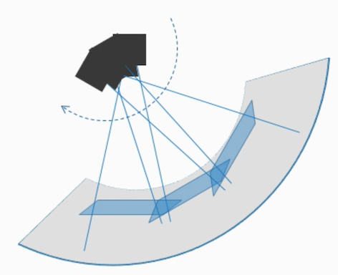

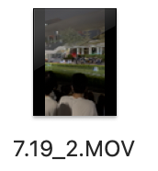
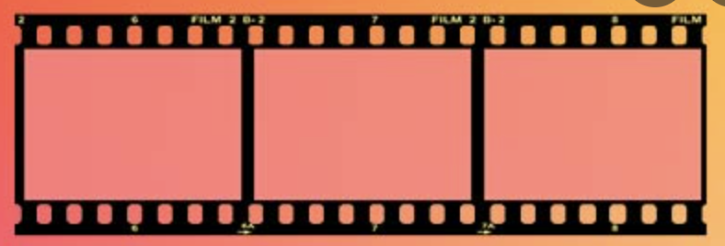
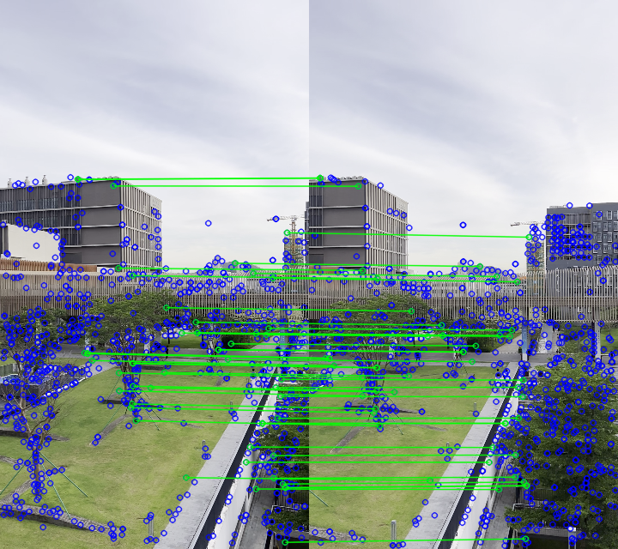
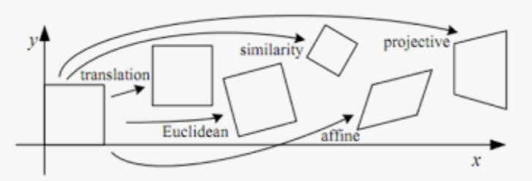
Goal and Methodology
Goal 1: Construct the panorama from a video
Goal 2: Deblur the video to get a high-quality panorama
Input video
Frame selection
Cylindrical projection
Deblur
Image warping/calibration
Image stitching

Slide 3
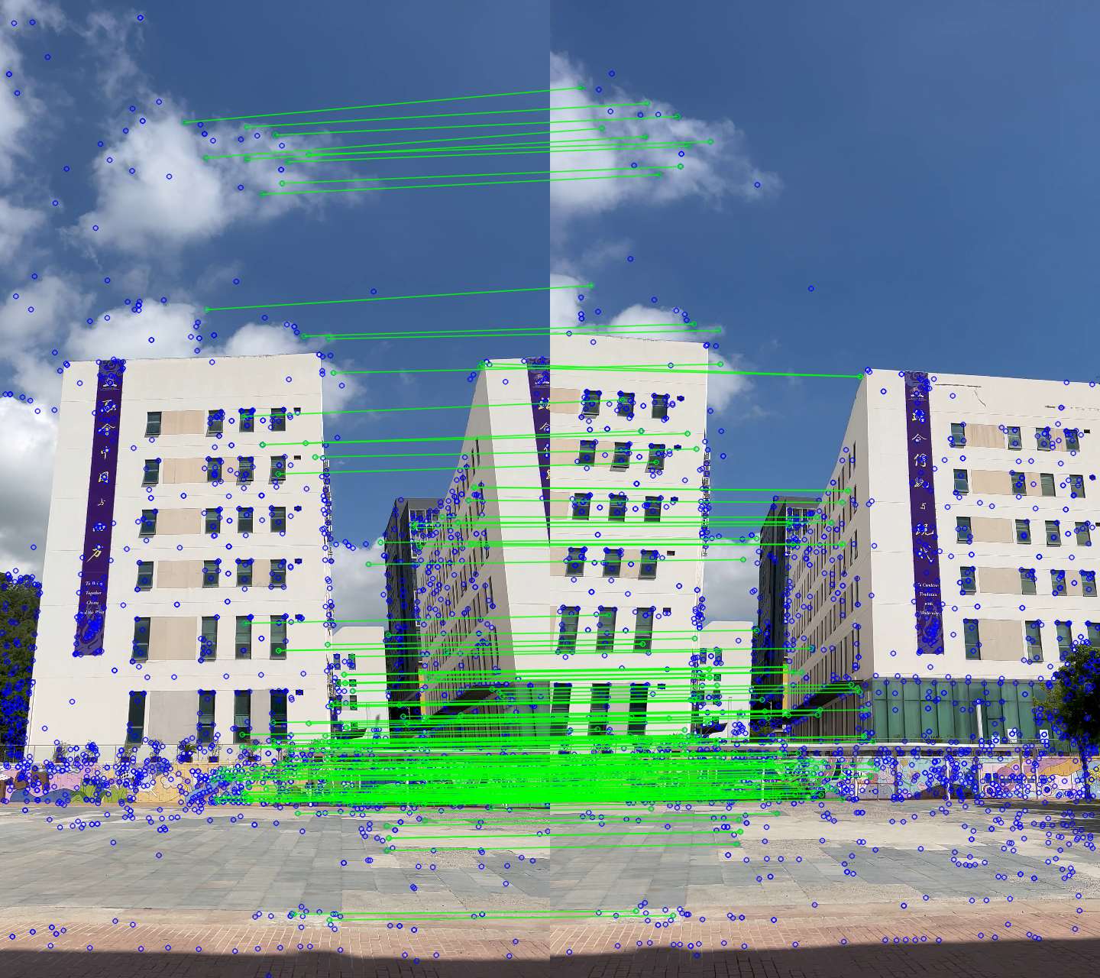
Methodology
1. Corner points detection using SIFT detector
Corner points of two images are detected by the SIFT (scale-invariant feature transform) algorithm.
The match of the points are analyzed by the RANSAC (random sample consensus) algorithm.
Corner points matching

Slide 4
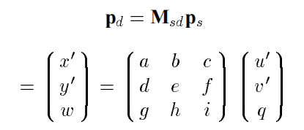
Methodology
2. Homography and warping the image
The least requirement:
4 match point pairs are needed
More then 4 points:
Use the least square estimation
Solve 9 variables with 8 degrees of freedom

Slide 5
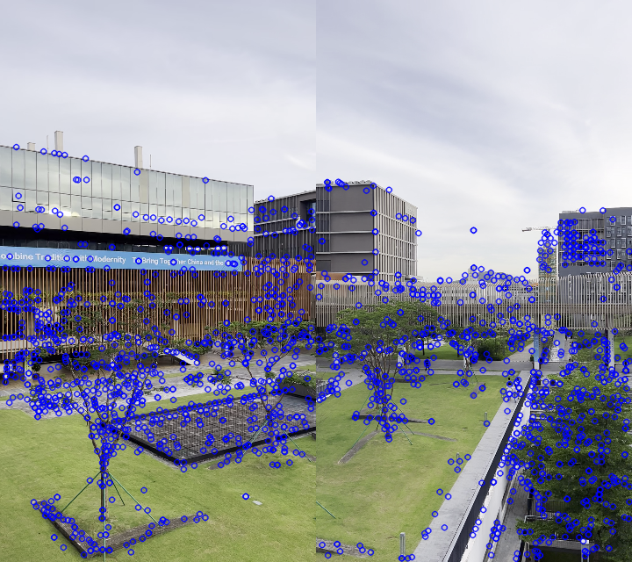
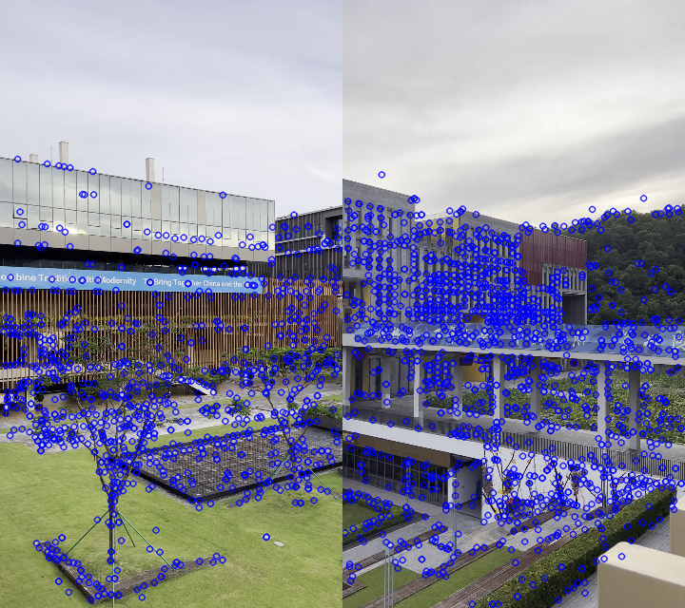
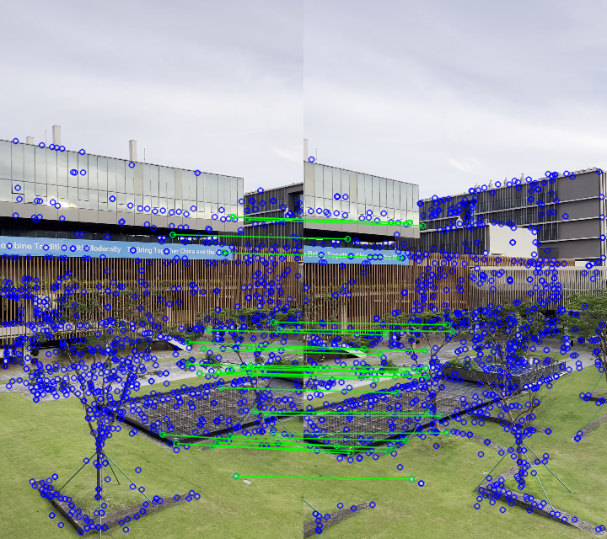
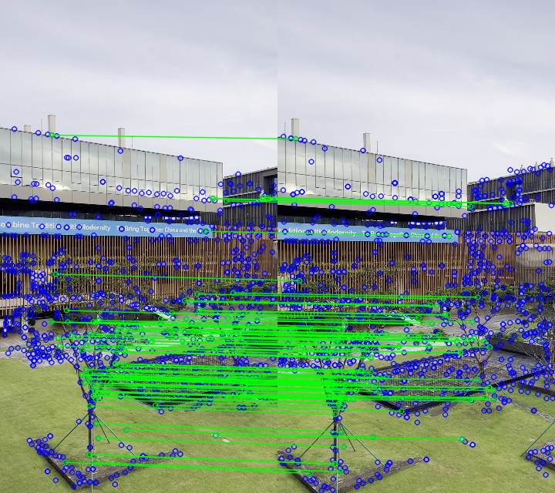
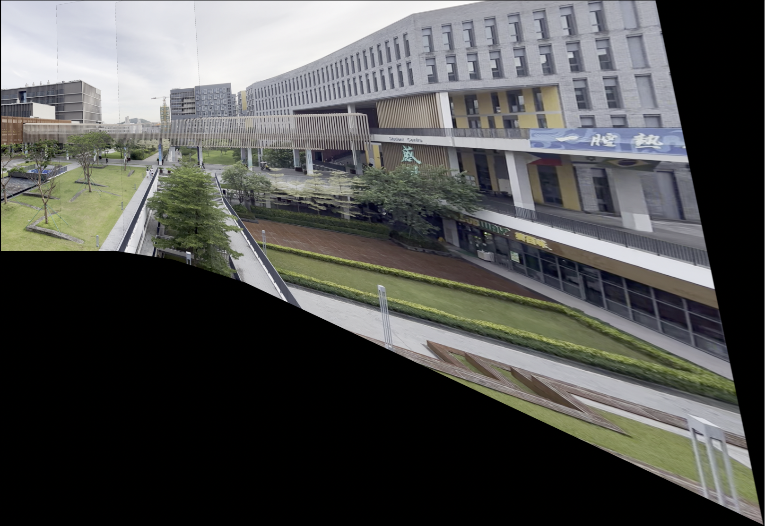
Methodology
3. Video frame selection
Binary Search:
Search (index1, index2):
if index2-index1<2 or reachCriterion (index1, index2):
add index1, index2 to selected frames
else:
Search (index1, (index1+index2)/2)
Search ((index1+index2)/2, index2)
Frame 1 – frame 154
Frame 1 – frame 308
Frame 1 – frame 39
Frame 1 – frame 77
reachCriterion (index1, index2) :
return (# of good match points (index1, index2)
> some number)
Assumptions:
The camera rotates to one single direction
The first frame does not overlap the last frame
Panorama constructed from the selected frames

Slide 6
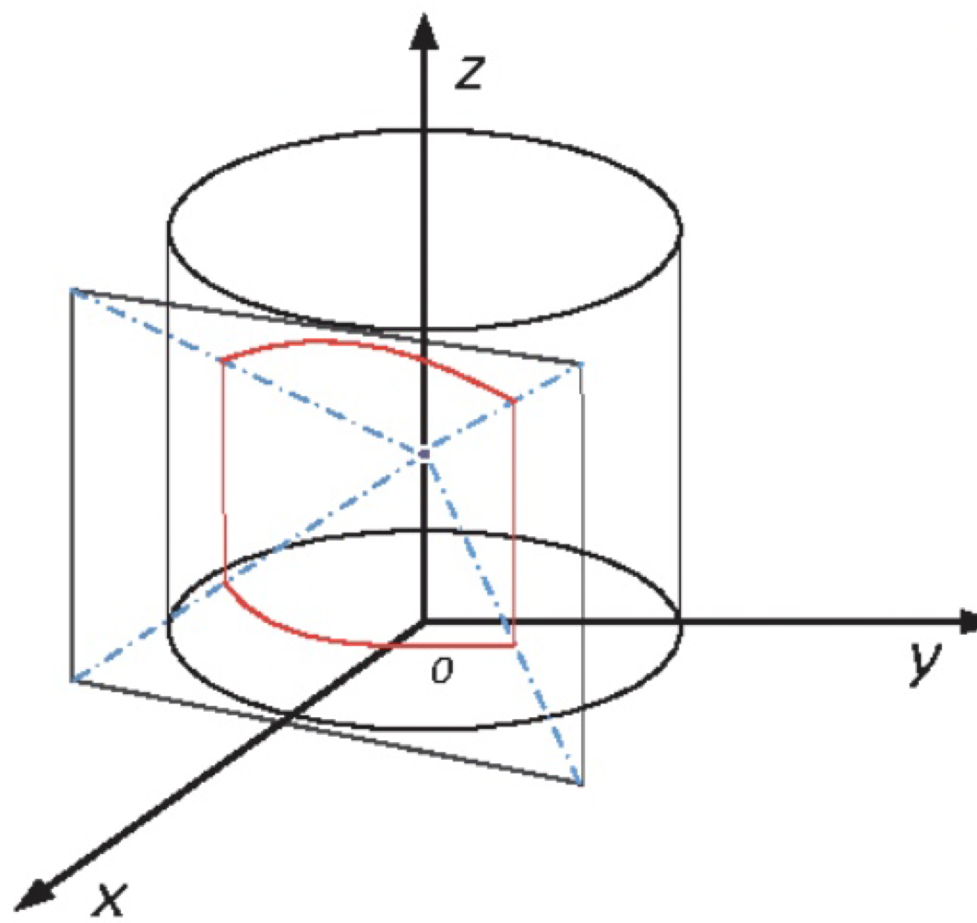
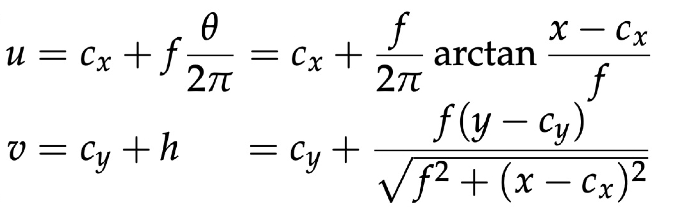
Methodology
Original image
Transformed image
4. Cylindrical projection
(x, y)
(u, v)

Slide 7
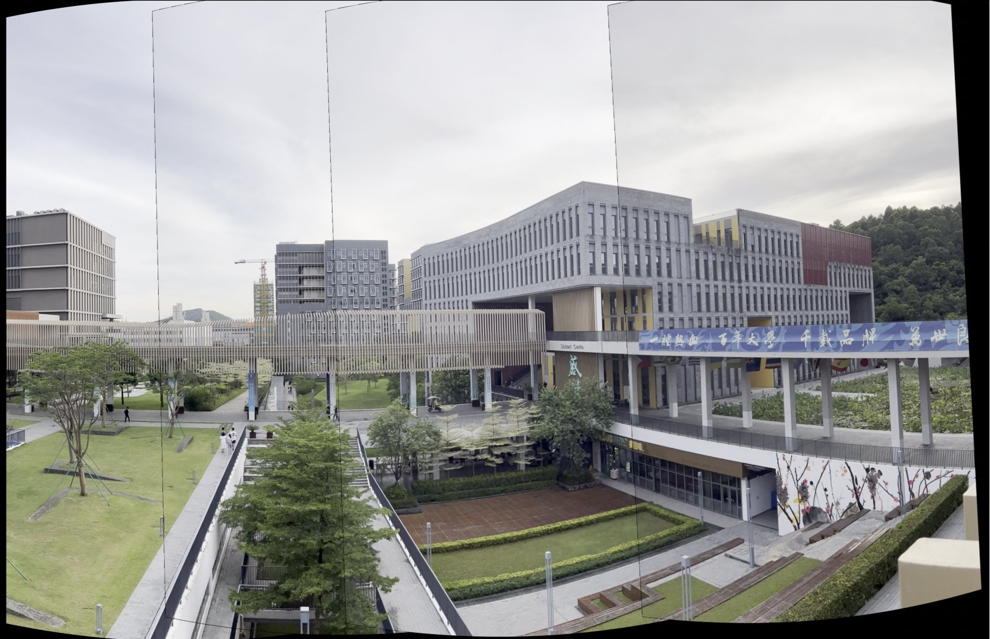

Slide 8
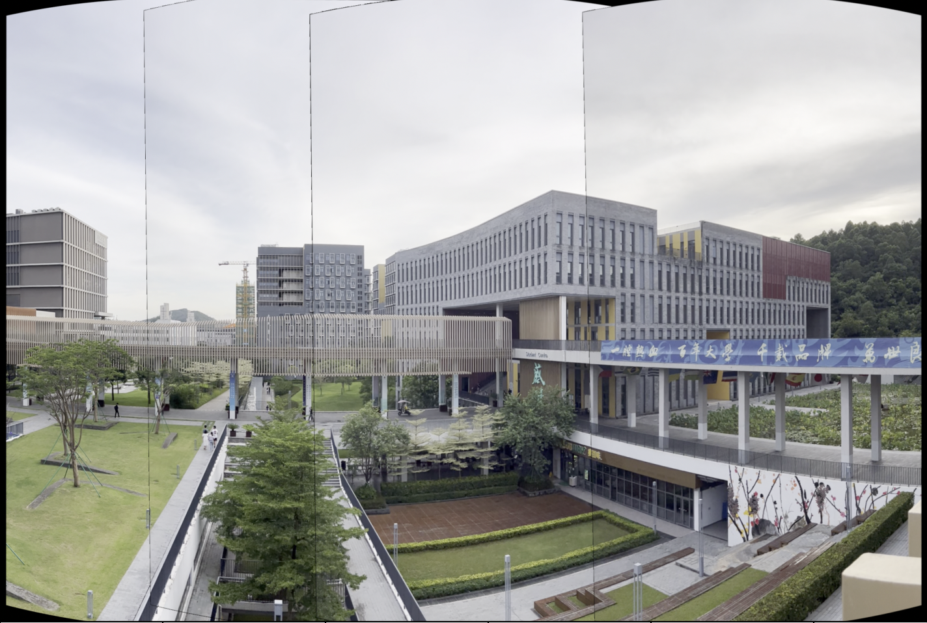
Methodology
5. Calibration of the image

Slide 9
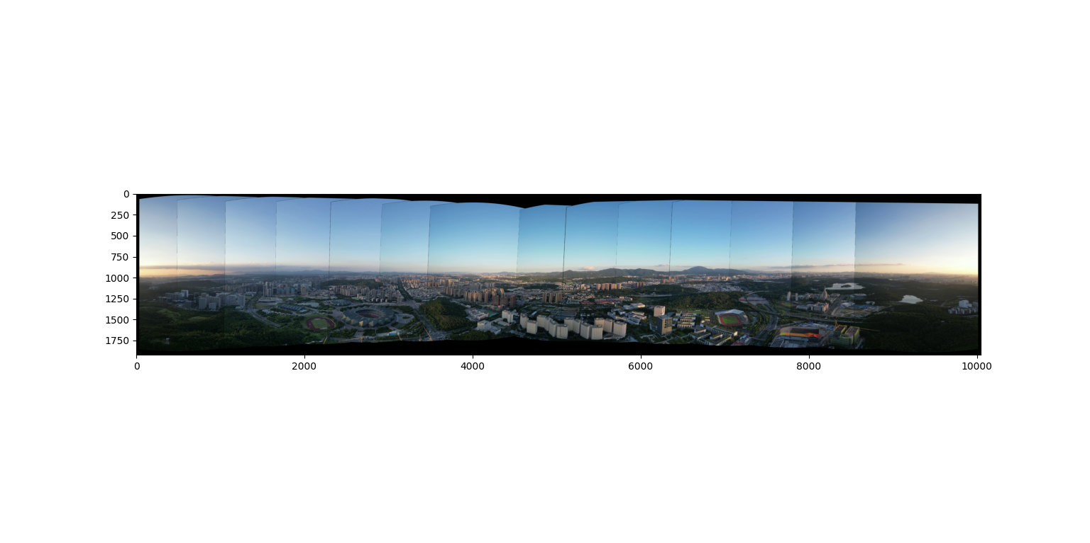
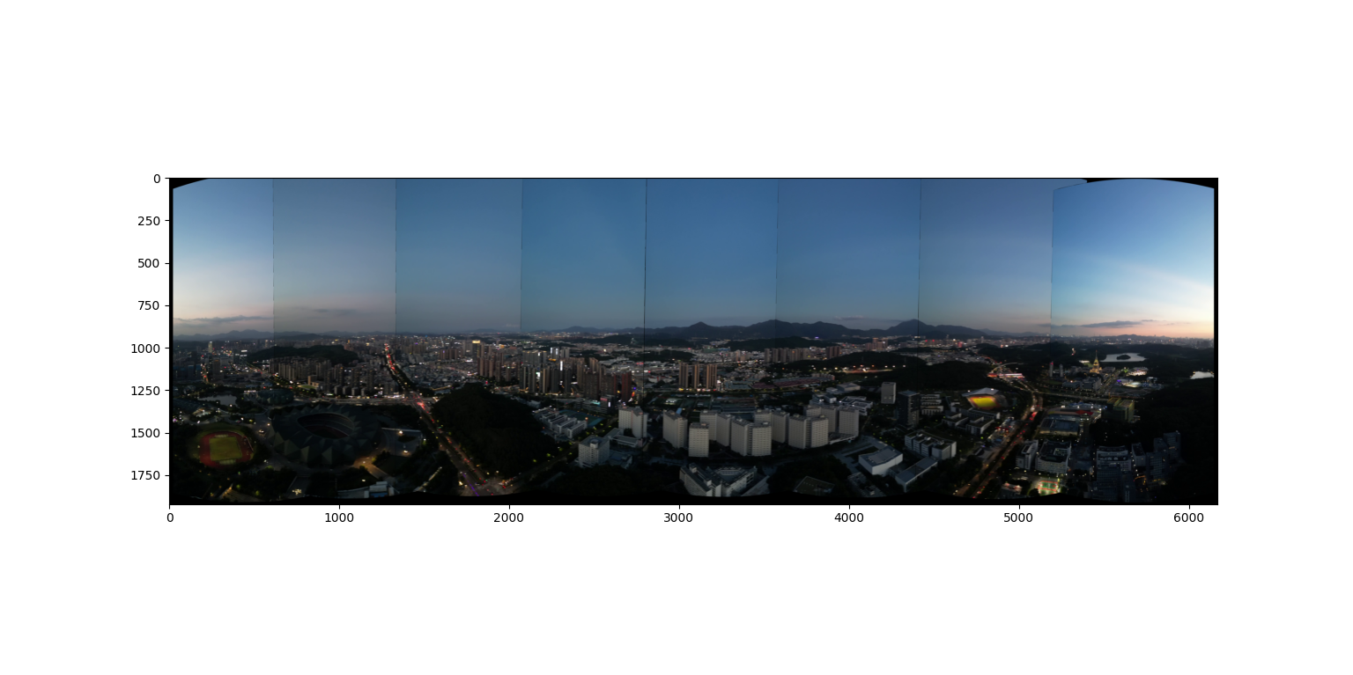

Slide 10
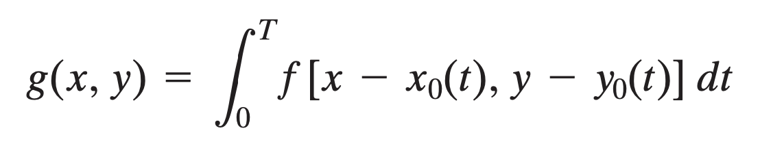
Methodology
6. Deblurring
Step1: Estimating X(t)
Assumptions:
The camera rotates at a single direction (from left to right)
During the exposure time at each frame, the rotating velocity is constant

Slide 11
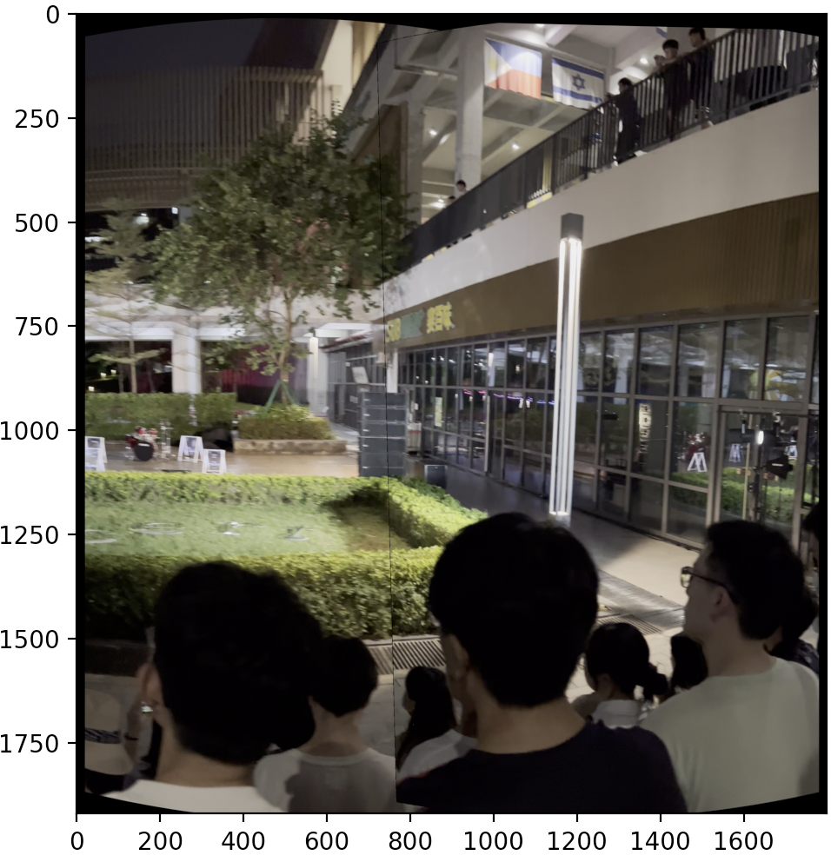
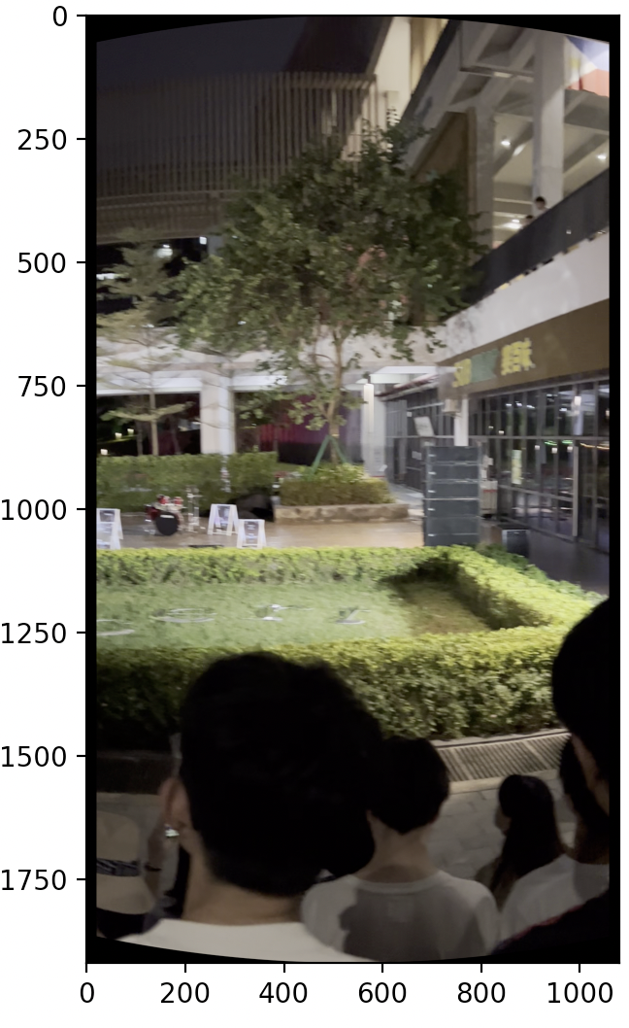
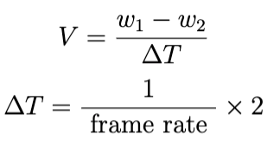
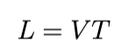
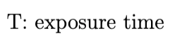
Estimating the motion of the camera
Total distance that image traveled during exposure time
w1
w2

Slide 12
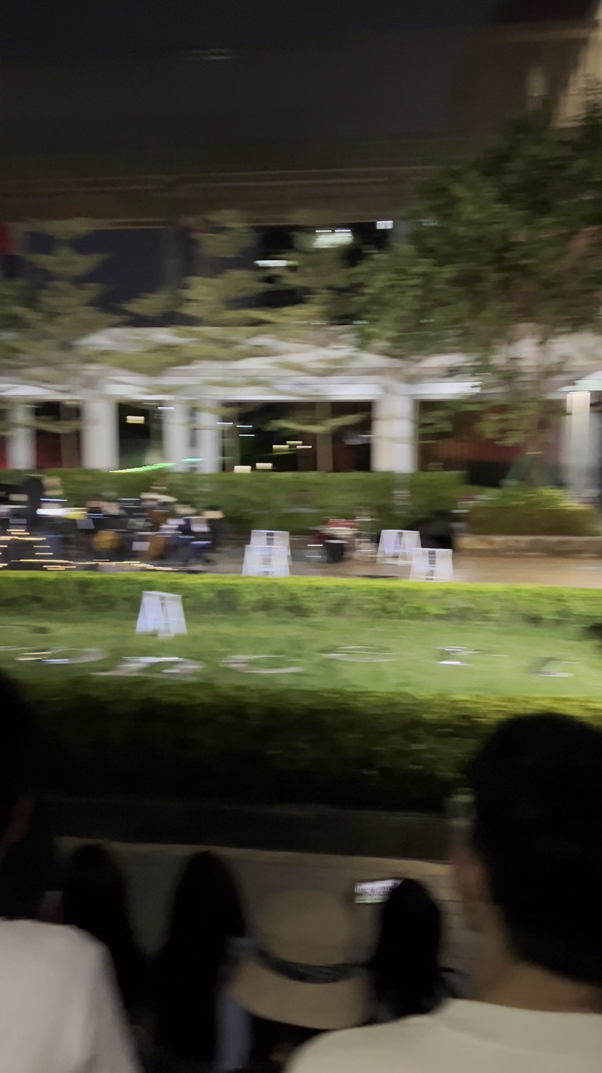
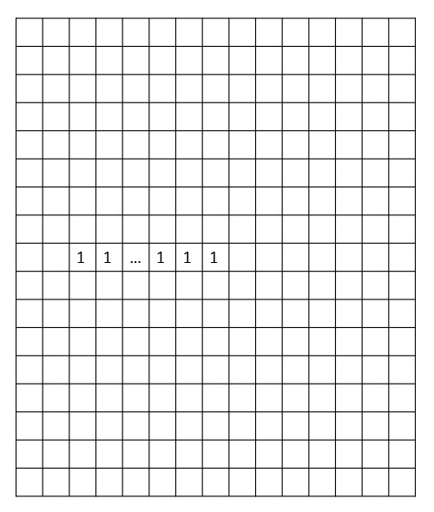
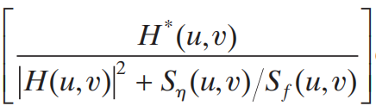
Methodology
6. Deblurring
Step2: Deblurring using wiener filter
FFT
Wiener’s filter
FFT
H
W
G
L
F = WG
Motion blurred image
Spatial filter of the horizontal motion blur
iFFT
Deblurred image

Slide 13
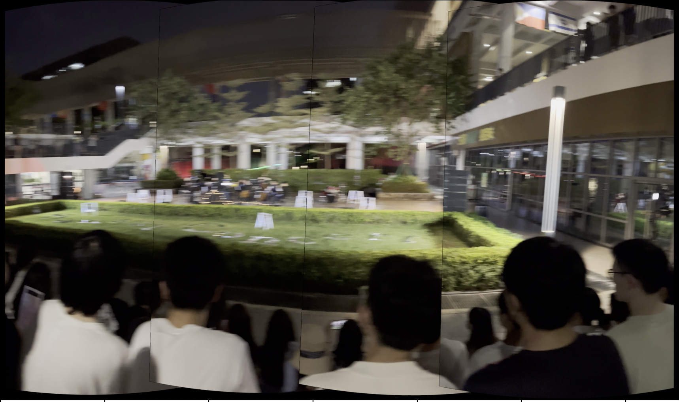
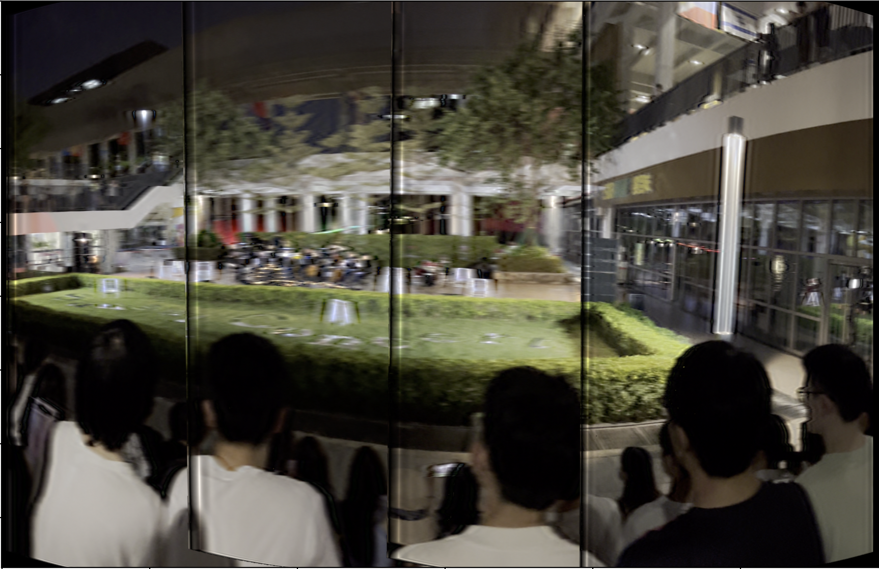
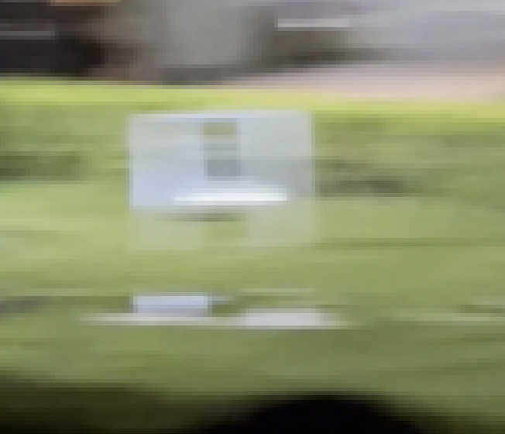
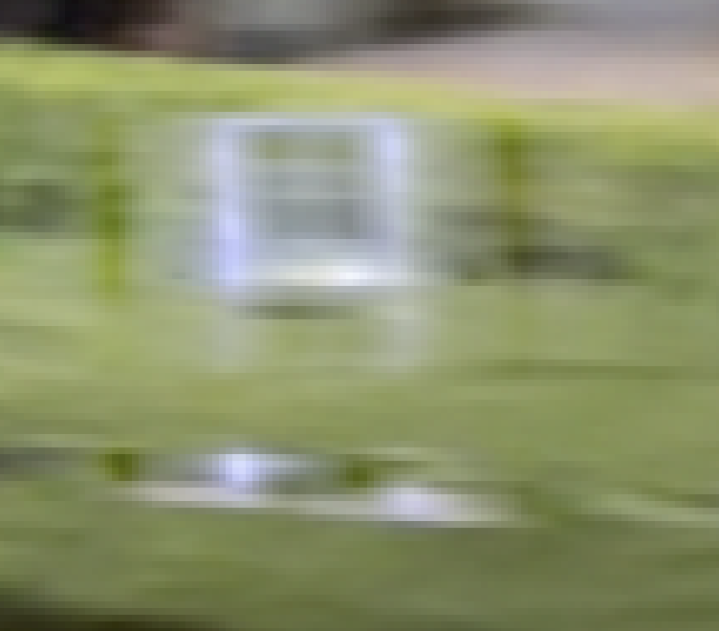

Before deblurring
After deblurring
Before deblurring
After deblurring

Slide 14
References
Brown, Matthew, Richard Szeliski, and Simon Winder. "Multi-image matching using multi-scale oriented patches." 2005 IEEE Computer Society Conference on Computer Vision and Pattern Recognition (CVPR'05). Vol. 1. IEEE, 2005.
Brown, Matthew, and David G. Lowe. "Automatic panoramic image stitching using invariant features." International journal of computer vision 74.1 (2007): 59-73.
Heckbert, Paul. "Projective mappings for image warping." Image-Based Modeling and Rendering 869 (1999).
Lin, Mingxiu et al. “Cylindrical panoramic image stitching method based on multi-cameras.” 2015 IEEE International Conference on Cyber Technology in Automation, Control, and Intelligent Systems (CYBER) (2015): 1091-1096.
Lowe, David G. "Object recognition from local scale-invariant features." Proceedings of the seventh IEEE international conference on computer vision. Vol. 2. Ieee, 1999.

Slide 15
Thank You

